Slide 1
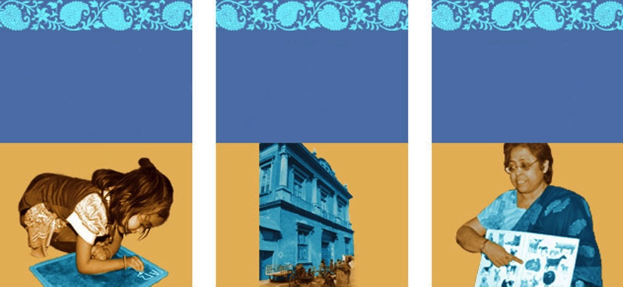

90 €
600 €
70 €
Stationary supplies
For 1 month
6 months rent
1 month salary
For 1 teacher
1 000 €
350 €
12 000 €
Texts books
For 1 year for 50 children
1 year at school
For 1 child
Annual budget to run
the Centre

